Slide 1
Wumpus Explorers

Slide 2
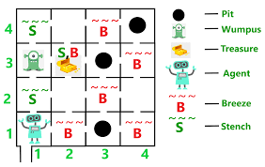
Concept
Notes:
Wumpus Explorers is a 3D adventure puzzle game based on the Wumpus World in which an AI agent must navigate through different rooms avoiding pitfalls and a monster called Wumpus while they seek a treasure. The difference in Wumpus explorers is that the Wumpus will be able to move around and there will be NPC competitors that will be racing the player to the treasure.

Slide 3
Alignment
Notes:
Genre: 3D Adventure/Puzzle
Mood: Thrilling/Fear
Pace: Evolving based on other actors & interactions.

Slide 4
The www
Notes:
What: Players will explore randomly generated caves composed of tiles and use stimuli to navigate around hazards.
Why: The player wants to collect the treasure before others and without dying so it can be sold for money
Where: Players are in caves exploring the terrain and looking for treasure to bring back out of the cave.

Slide 5
Risks
Notes:
NPC Behavior & Systems – functioning NPC system gives the game its pacing, otherwise it’s just a stroll in the park
Level Generation - Must work 100% of the time to have gameplay loop
Stimuli accuracy & visibility – Needs to be timed well & with correct proximity for player & NPCs to make well-informed decisions.

Slide 6
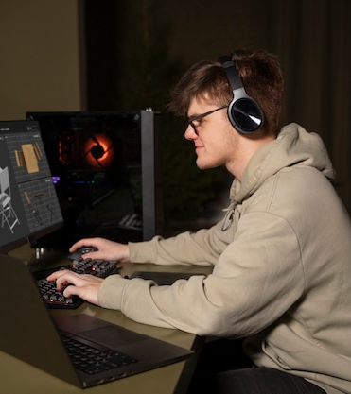
The market
Notes:
James is a college student who enjoys playing all types of games. He is most interested in 3D adventure games that provide a challenge such as competing against NPCs and completing objectives.

Slide 7
Core Mechanics
*Player Movement
*Hazards
*Room Hiding
*Item Collection
*Sensory System
Notes:
Core mechanics of this game are
-Player movement- the player is able to move freely throughout the level
-hazards- hazards include pitfalls and an enemy character that both cause a game over instantly
-Room hiding- adjacent rooms stay hidden until the player actually enters the room
-Item collection- The main goal of the game it to collect the treasure and escape safely from the “cave”
-Sensory system- Notifies the player and NPCs if adjacent rooms contain a hazard or treasure

Slide 8
Core dynamics
*Wumpus
*Level Generation
*NPC
Notes:
Core dynamics are
-Wumpus- Enemy character who will eat the character if they enter the same room as him
The Wumpus starts in a room and will work his way around the level moving to an adjacent room every few seconds while the player is trying to find the treasure. This adds the dynamic of needing to be careful to avoid the Wumpus while traversing the level.
-Level Generation- a system that spawns a level every time the player starts the game. The level will automatically be populated with 3 pitfalls, 1 treasure, and 1 Wumpus. The locations will be randomly chosen by the system so that the challenge will be different each time
-NPCs will also be trying to seek the treasure, adding an extra layer of challenge. The NPCs will also be able to make informed decisions based on the sensory system.

Slide 9
organization
Notes:
Stephen Main: Production, QA & Fixes
Demonte’ Taylor: Player Control Mechanics (Programming )
Jayden Patton: NPC Behavior / Level Generation (Programming) & game audio
David Novotny: QA & Fixes
Chardonnay Young: Narrative, UI, and Level Design
Shelbi Short : Narrative, UI, Level Design, and programming level-specific logic

Slide 10



tools
Notes:
We are using Unreal Engine 5 for the gameplay creation, GitHub for source control and Blender for creating art assets

Slide 11

Thank you
Stephen Main
David Novotny
Chardonnay Young
Demonte’ Taylor
Shelbi Short
Jayden Patton

Slide 12
References
https://www.freepik.com/free-photos-vectors/game-designer
https://www.geeksforgeeks.org/ai-the-wumpus-world-description/
https://pngimg.com/image/73355
https://www.gamedeveloper.com/business/unreal-engine-5-has-officially-launched
https://www.blender.org/about/logo/

